Slide 1

Surety Company Annual Reports (Form S-1)

Slide 2
Agenda
Problem Statement
Current Business Process for Existing Filers
Requirements
Recommended Solution
Questions

Slide 3
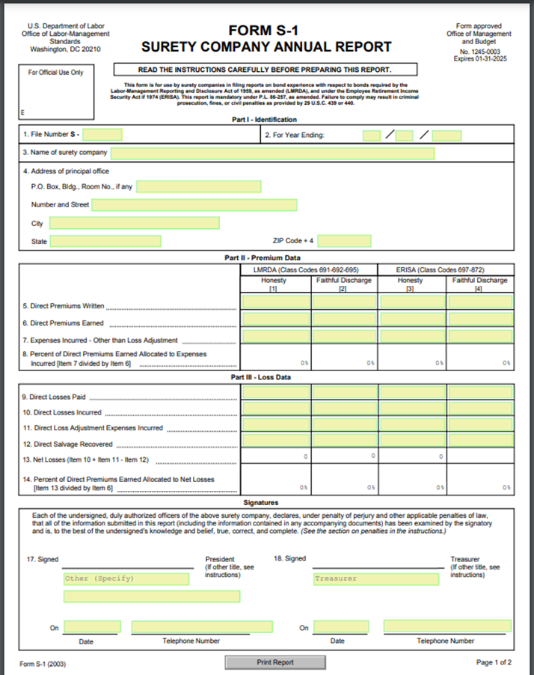
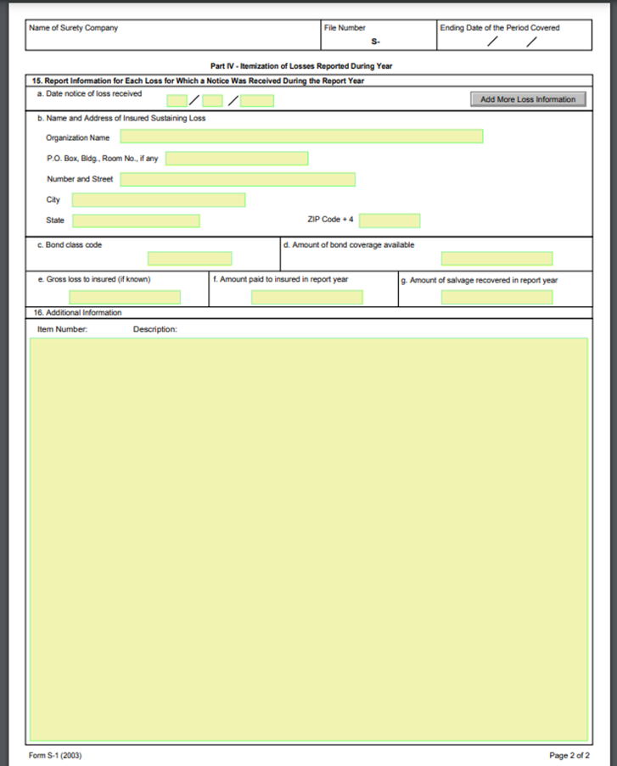
Problem Statement
The current S-1 filing process is:
Manual
Inconsistent Reporting
Time Consuming
Page 1
Page 2

Slide 4
Current Process (Existing & New Filers)
Reminder email sent to Surety company
DCA receives S-1 report from Surety company
S-1 shared with DO and EBSA
DCA sends a reminder email to Surety companies that have filed the previous year
For new filers, DCA staff assigns next sequential file number to received S-1
DCA staff does a basic audit to check for missing information.
Staff scans these reports and stores PDF files on the ‘Y’ drive by year.
Staff logs received S-1’s on to a spreadsheet used to manage and track all submitted forms each year.
Email containing the LMRDA codes, along with all the corresponding S-1 reports, sent to the district office responsible for the bonded union.
Email containing the ERISA codes, along with all the corresponding S-1 reports sent to EBSA
Note: There is no process for knowing/identifying new Surety Organizations that are required to file S-1’s.

Slide 5
High Level Requirements
Process | Requirement | Responsible
Paper based submission | Maintain ability to receive paper reports by creating a new electronic capability Migrate existing files to this new electronic capability | Development Team
Registration of filers | Build new capability for filers to send in requests to DCA to get associated to file numbers, obtain new file number DCA will administer access for filers, register new surety organization and generate new file numbers in the new electronic capability | Development Team OLMS DCA
Electronic submission | Facilitate electronic submission process in EFS. Allow DCA to review attachments before publishing to OPDR (Disclosure). Note: Only attachments need to go through the review process not the report. Implement functionality to retrieve LMRDA and ERISA codes from electronic S-1 content | Development Team
Electronic S-1 report content | Ability to amend previously submitted reports S-1 Form must have validations based on collected business rules | Development Team
Communication | System generated emails for Surety companies, DO’s and EBSA to share reports and send reminder emails. | OLMS DCA/ Development Team
Public Disclosure | Display submitted reports in OPDR (paper and electronic) | Development Team

Slide 6
Recommended Solution

Slide 7
Applications
Application | Function
EFS | User registration Electronic submission of S-1
New Application- RAMPS (Report Administration Management Processing System) | Add new Surety organizations, edit existing Surety organizations Manage paper reports Review S-1 attachments before OPDR publication Add registered users to file numbers Allows system generated emails to be sent
OPDR | Public disclosure of S-1 reports

Slide 8
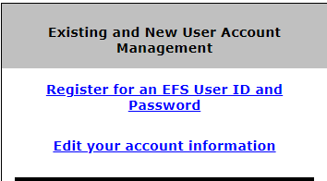

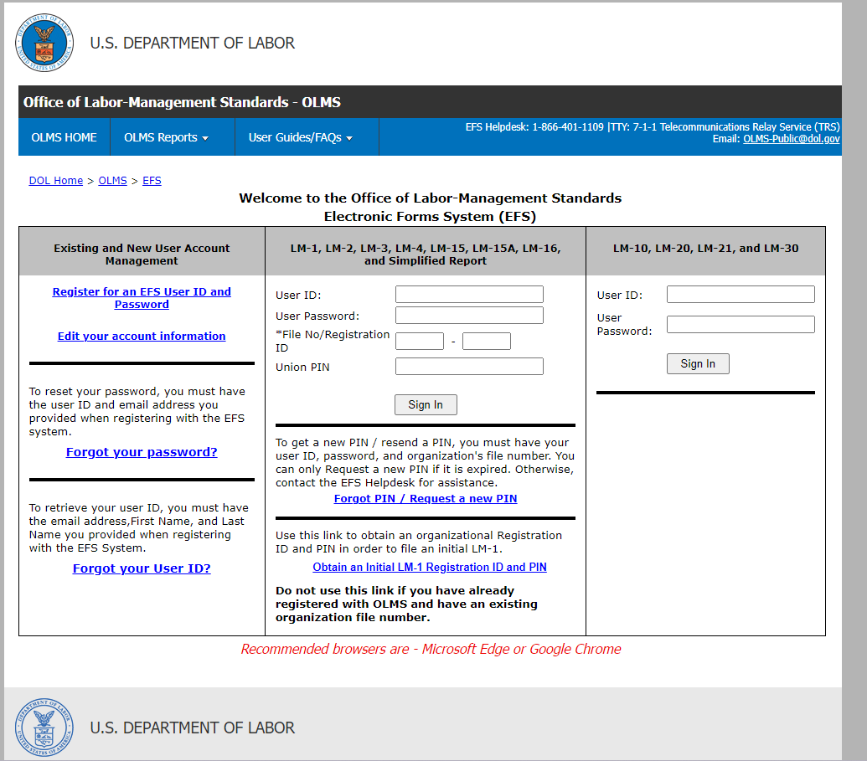
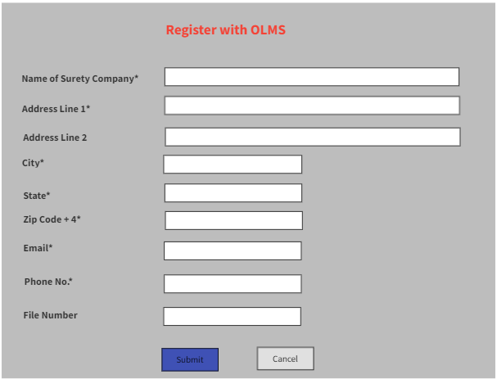
STEP 1 : Register for EFS User ID and Password
Registration and filing process of S-1
STEP 2 : Register as a S-1 filer
Adding a new areas to the existing EFS login page. All electronic S-1 filers are required to register for an EFS User ID and Password and a separate login as an S-1 filer.

Slide 9
STEP 3 : DCA approval of S-1 registration
All requests undergo review by DCA staff in the RAMPS application.
Staff verifies the submitted information and links the user to appropriate surety organization/file number.
If the surety organization is new, it is registered prior to associating the user.
Upon approval, a DCA confirmation email is sent to the user.

Slide 10
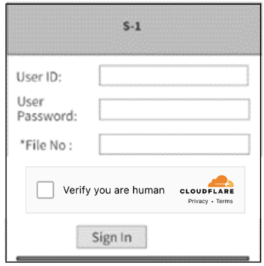
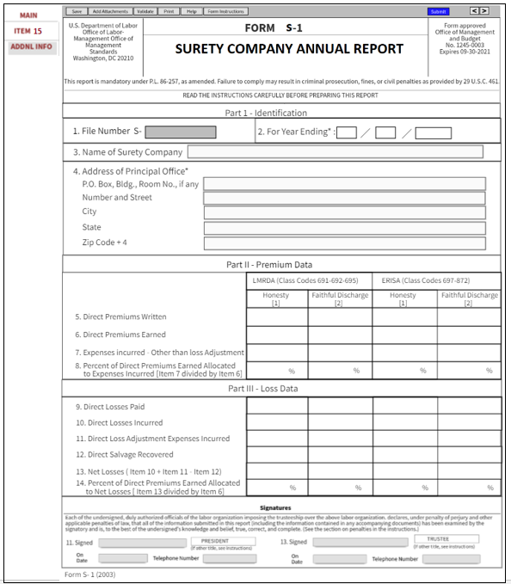
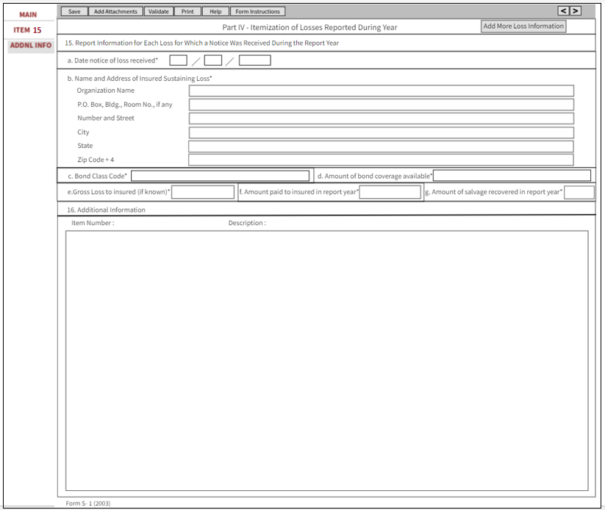
STEP 4 : Sign In to EFS and complete S-1 form
Upon receiving confirmation email from DCA, the user can proceed with EFS S-1 login.
S-1 form is completed and submitted.

Slide 11
OPDR publication, RAMPS automated email communication
Surety reports published in OPDR after submission.
Reports with attachments reviewed by DCA in RAMPS. DCA decides whether to publish attachment or retain it.
System-generated emails from RAMPS to DOs and EBSA.
Emails contain S-1 reports and LMRDA or ERISA codes.

Slide 12

QUESTIONS

Slide 13
THANK YOU

